Slide 1
Airbnb Seattle Data
Group FSP8T01
P.S. Please restart the Jupyter notebook kernel if necessary and re-run it for installed modules. Thank you.

Slide 2
How can a user navigate airbnb effectively, easily, and in an informed manner?
Can the listings be categorised into different quality? (Desmond)
What is a reasonable price for a particular listing? (Khee Gin)
Is there anytime in the year when there are less available listings and higher prices? (Khush)
What is the likelihood of a listing(s) being booked? (Chao Shan)
What ratings would this listing get? (Everyone)
Notes:
1.Can the listings be categorised into different quality?<br>
2.Is there anytime in the year when there are less available listings and higher prices?<br>
3.What is the likelihood of a listing(s) being booked?<br>
4.What is a reasonable price for a particular listing?<br>
5.What ratings would this listing get?<br>

Slide 3
PROBLEM
Can the listings be categorised into different quality?

Slide 4
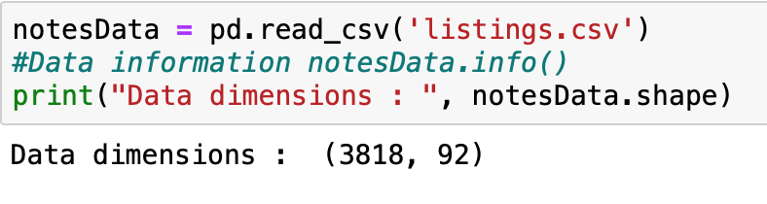
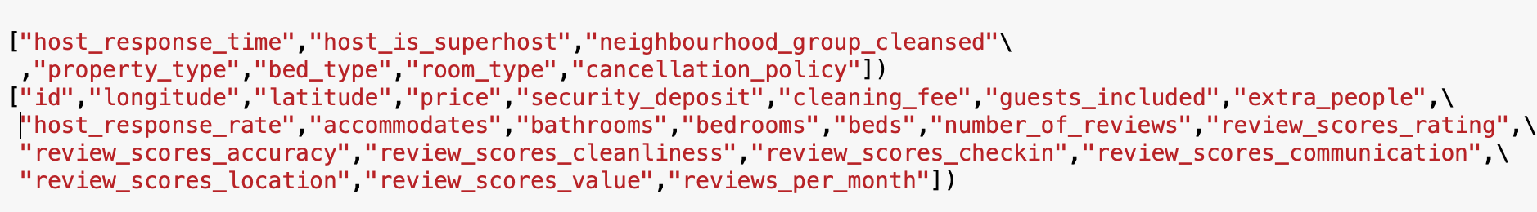
Can the listings be categorised into different quality - Data preparation
Import csv file
Extract relevant data

Slide 5
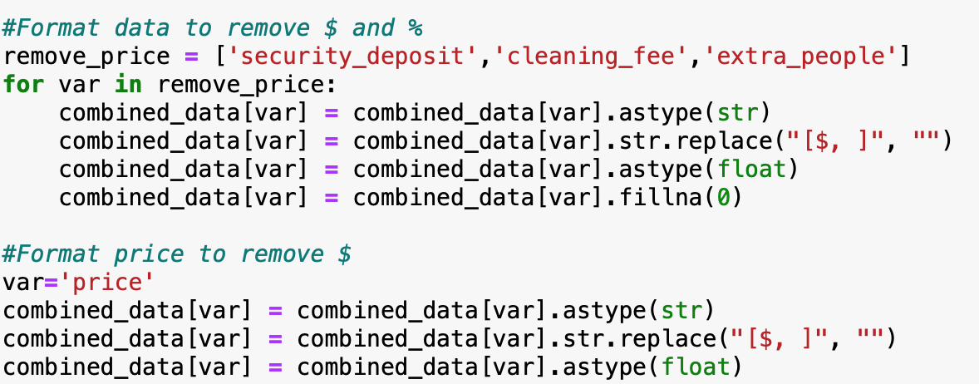
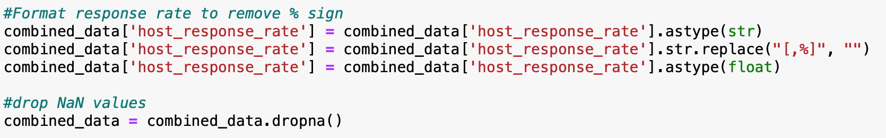
Data preparation
Clean dataset - remove $ and % sign, drop NA values

Slide 6
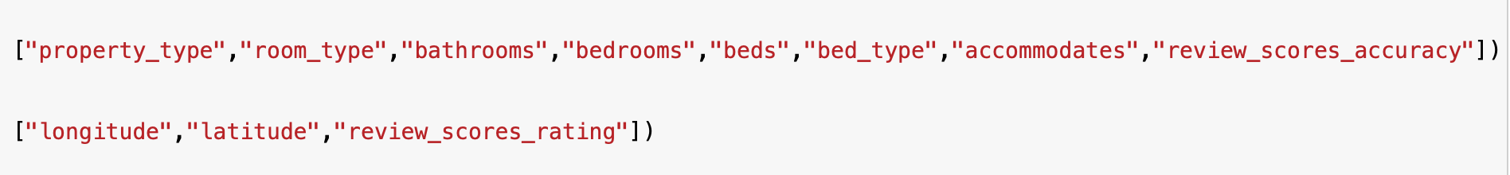
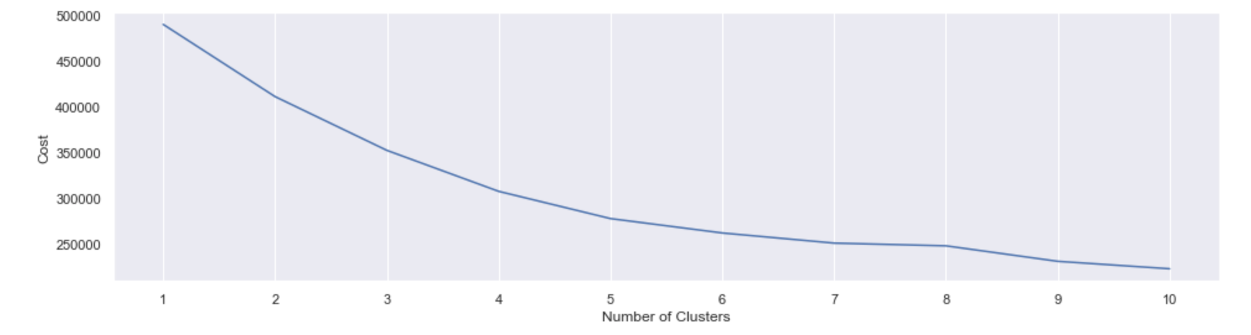
Clustering based on quality of houses
Joint_df: Numeric and categorical variables
Plotting elbow curve for Kprototypes (clustering for categorical and numeric data)
High rate of cost reduction (Cluster 5)

Slide 7
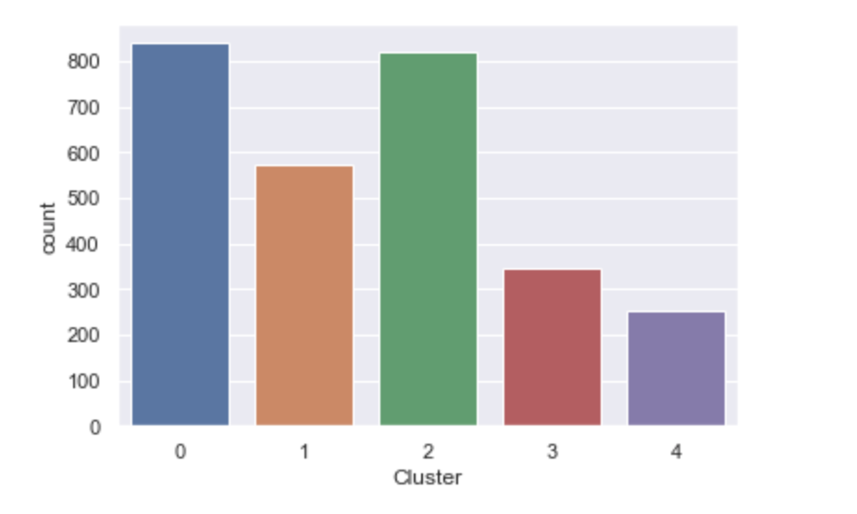
Clustering based on quality of houses
5 reasonably-sized clusters (Total number of listings: 2834)

Slide 8
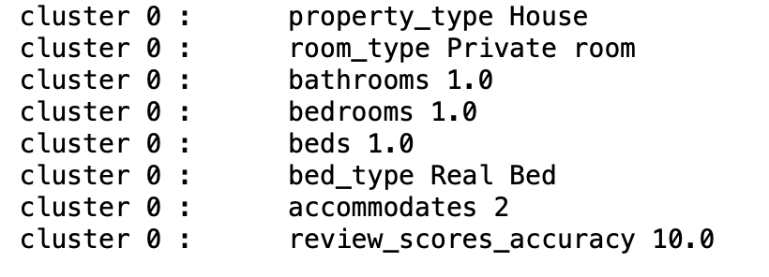
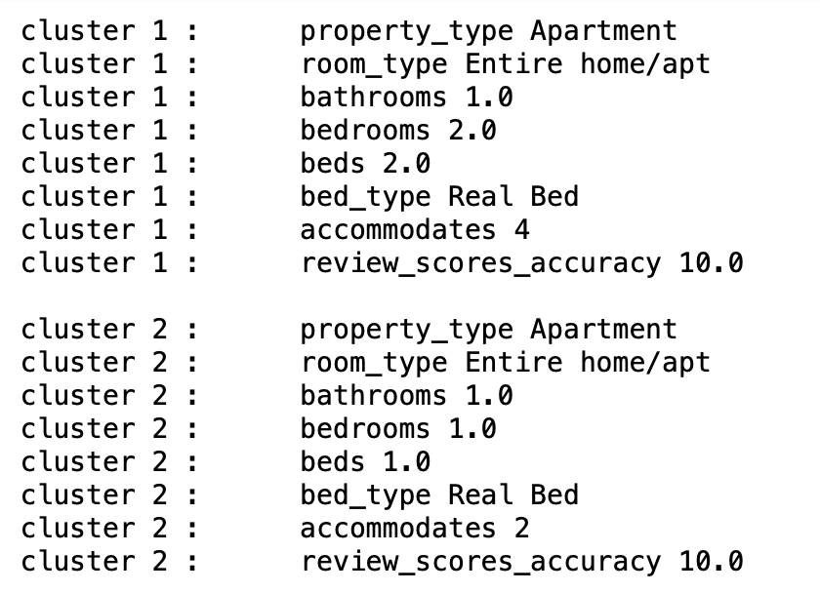
Cluster centroids - categorical variables
Small-cheap listings -
Usually:
1 bed, 1 bedroom, accommodates 2
Private room
Medium listings -
Usually:
2 bedrooms, 2 beds, accommodates 4
Entire home
Small-high-quality listings -
Usually:
1 bed, 1 bedroom, accommodates 2
Entire home

Slide 9
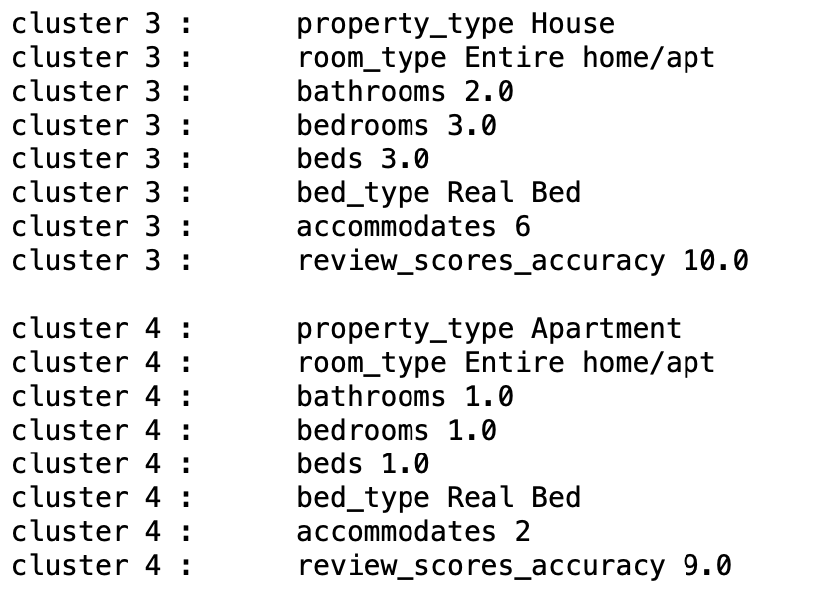
Cluster centroids - categorical variables
Large listings - Usually:
3 beds, 3 bedrooms, accommodates 6
Entire home
Small-low-quality listings -
Usually:
1 bed, 1 bedroom, accommodates 2
Entire home
Lower review scores accuracy (9.0) and ratings

Slide 10
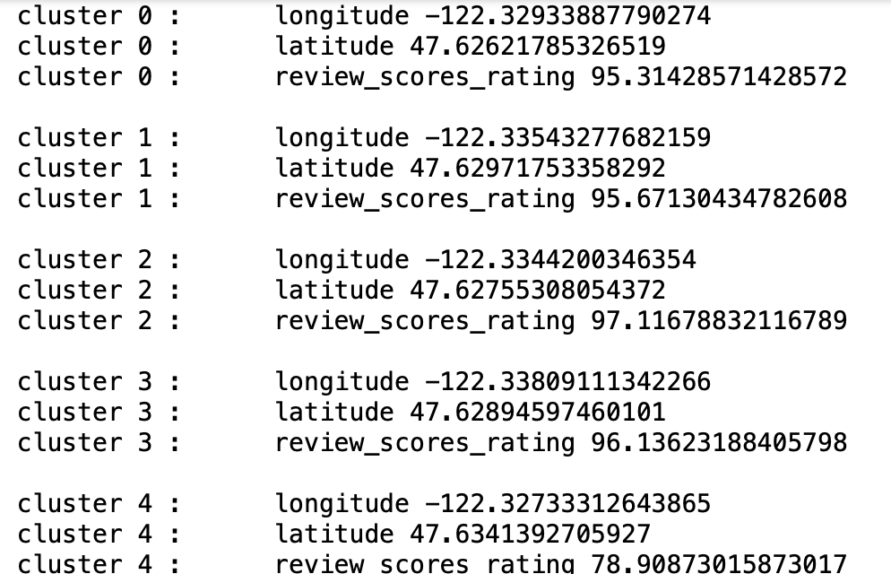
Cluster centroids - numeric variables
Small-low-quality listings (Cluster 4) -
Lower review scores ratings

Slide 11
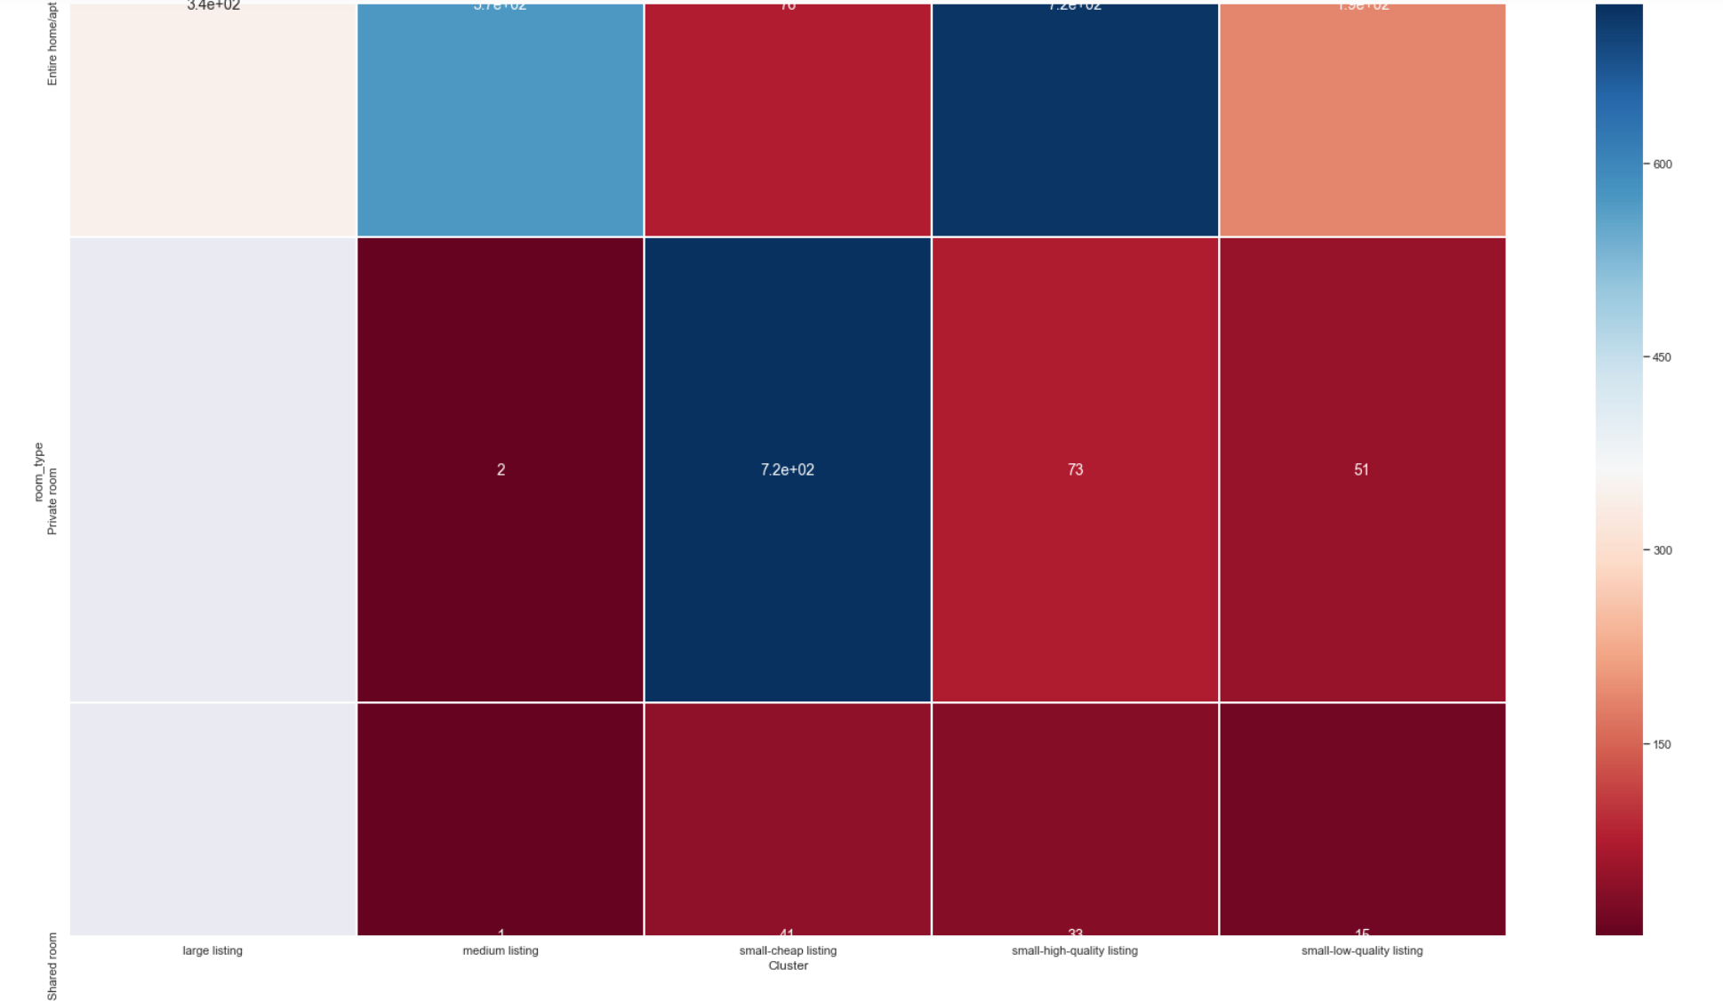
Visualisation of ‘room_type’
Entire home/Apt
Private room
Small-cheap listing

Slide 12
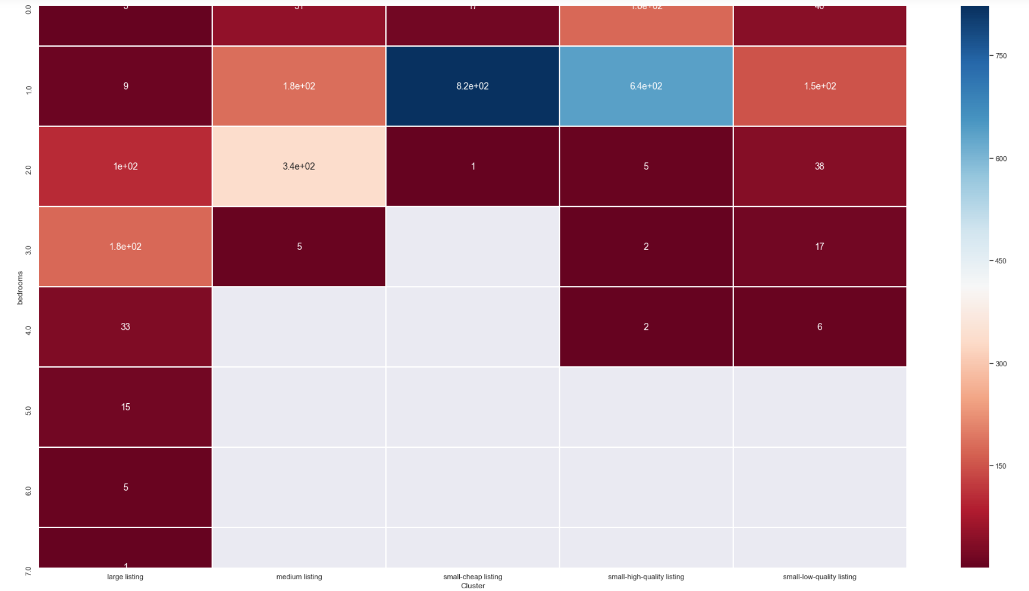
Visualisation of ‘bedrooms’

Slide 13
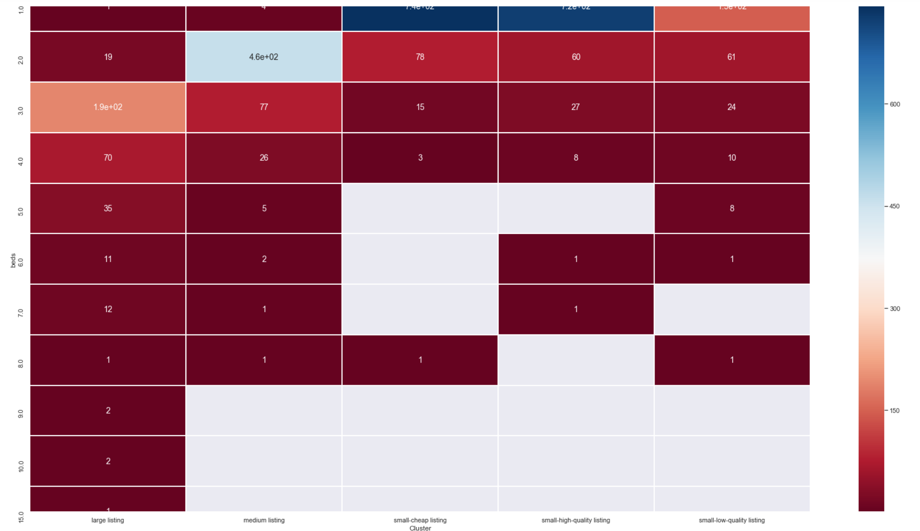
Visualisation of ‘beds’

Slide 14
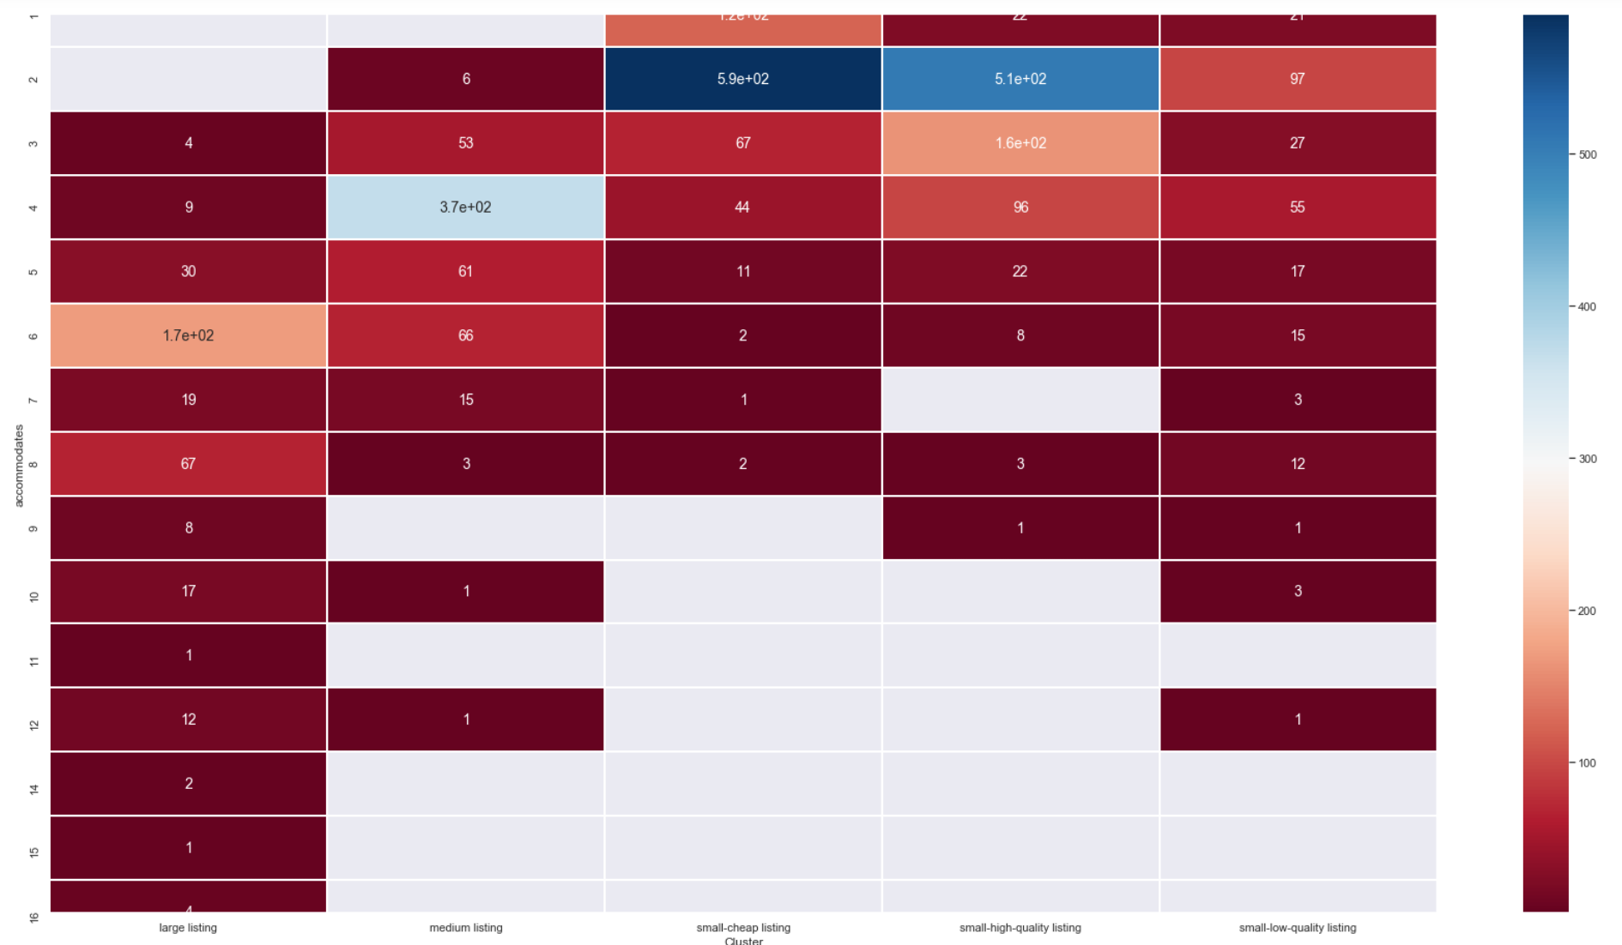
Visualisation of ‘accommodates’

Slide 15
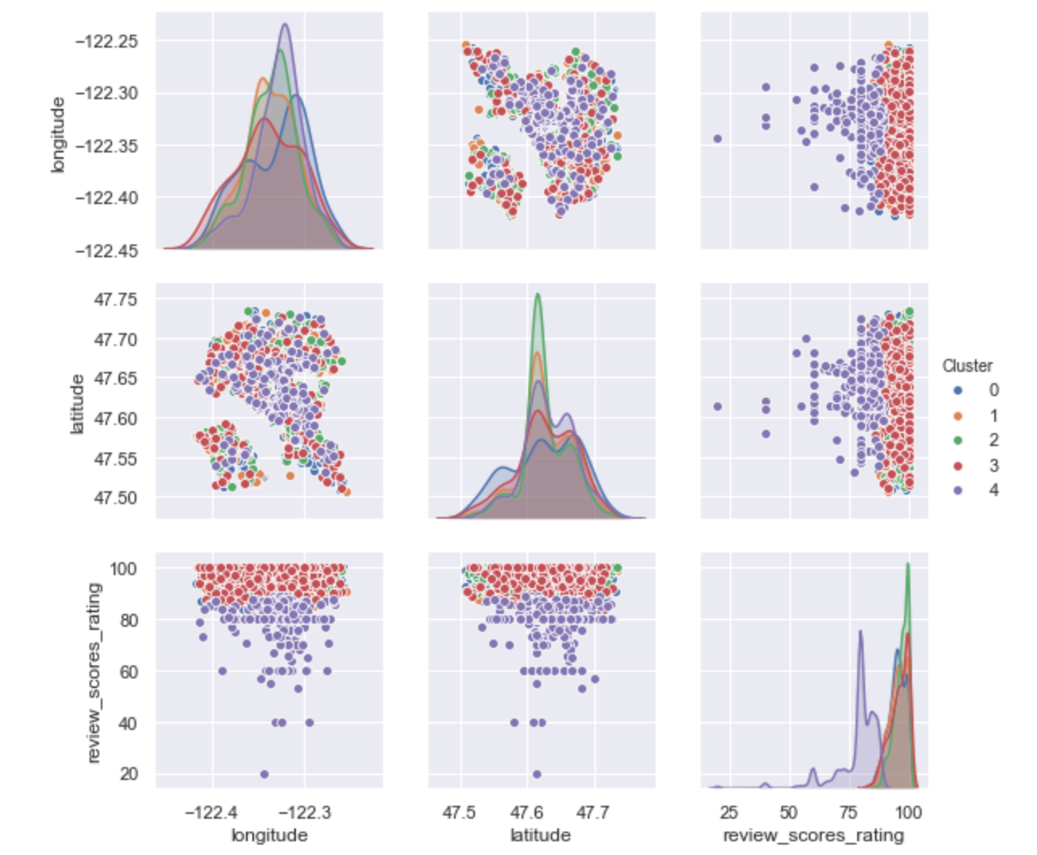
Visualisation of numeric variables
Small-low-quality listings (Cluster 4) -
Lower review scores ratings

Slide 16
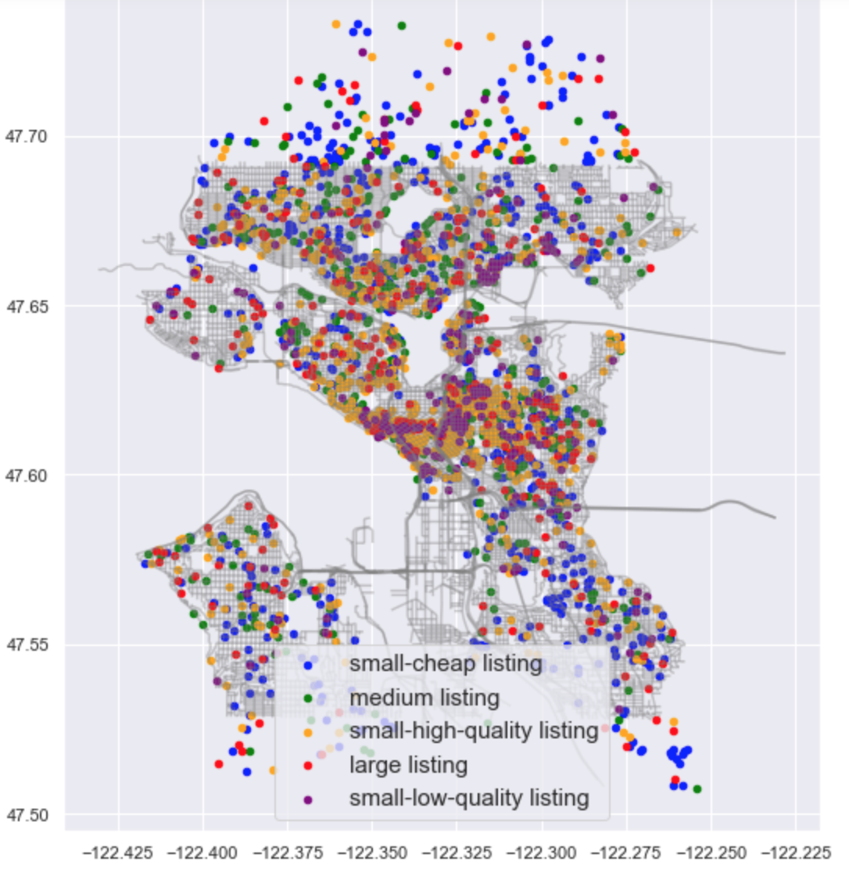
Visualisation of listings distribution
Even distribution of listings across Seattle

Slide 17
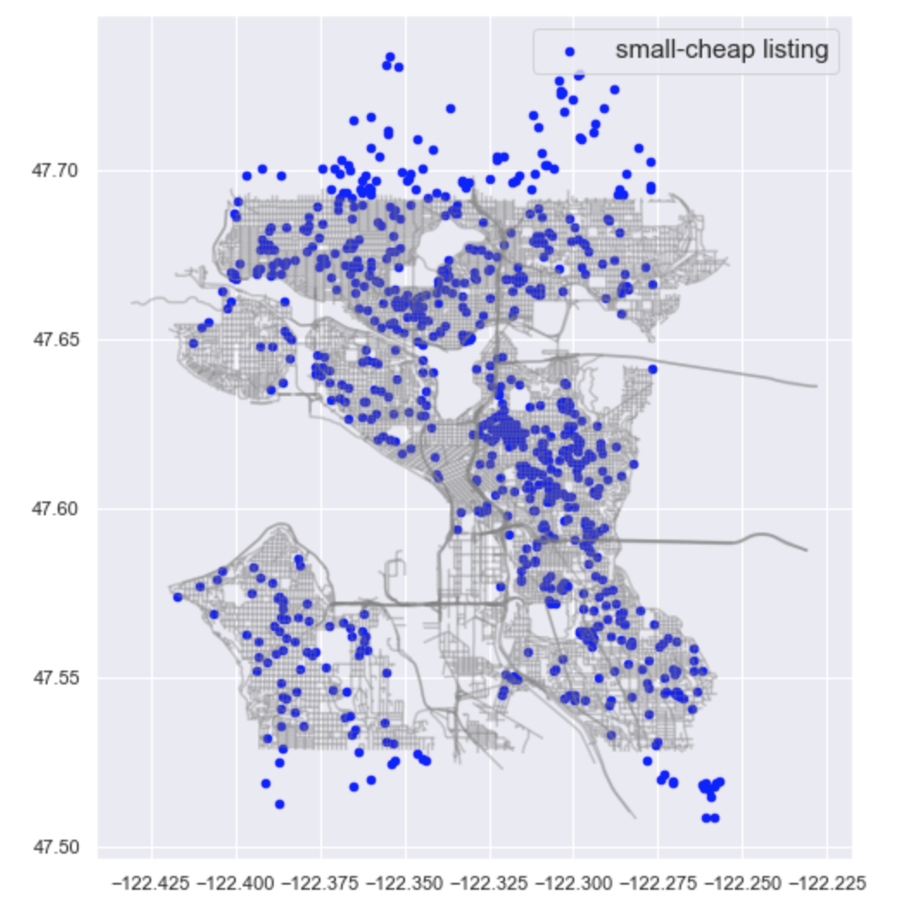
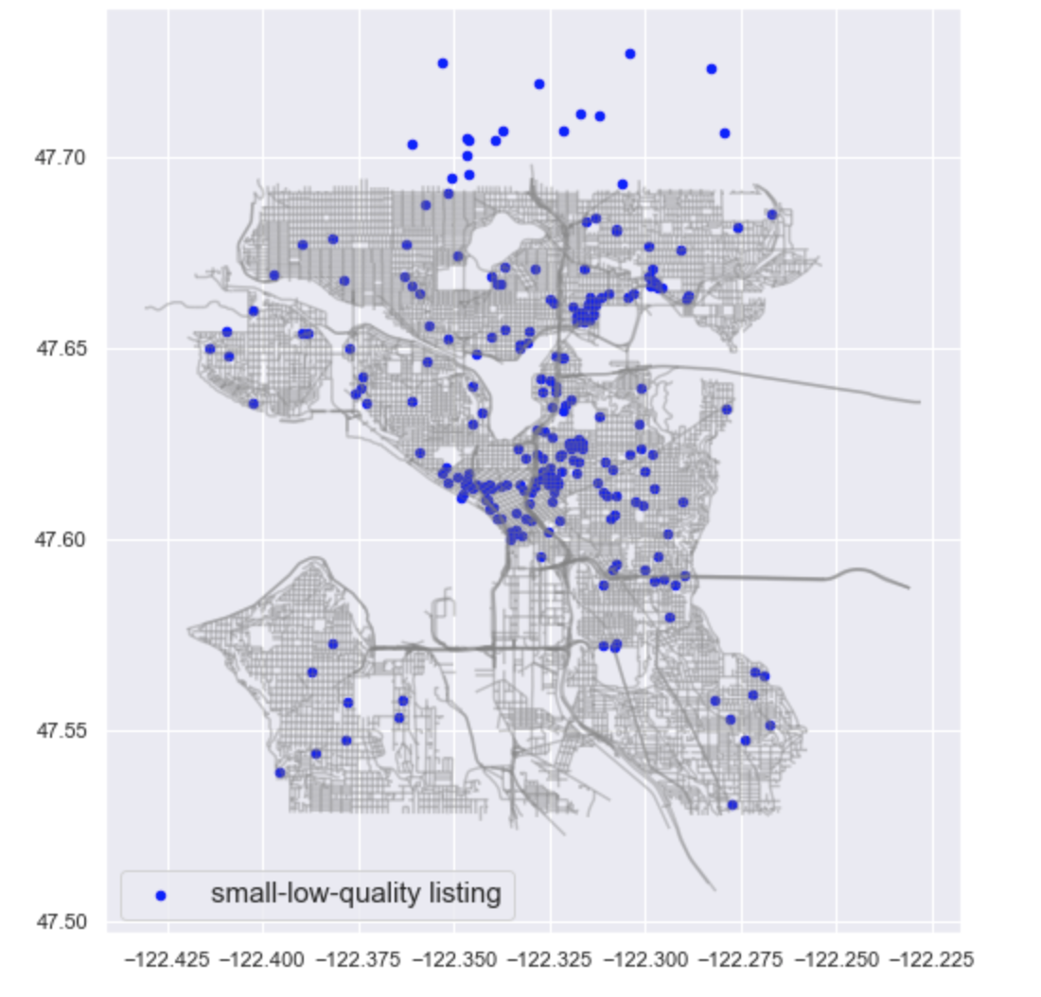
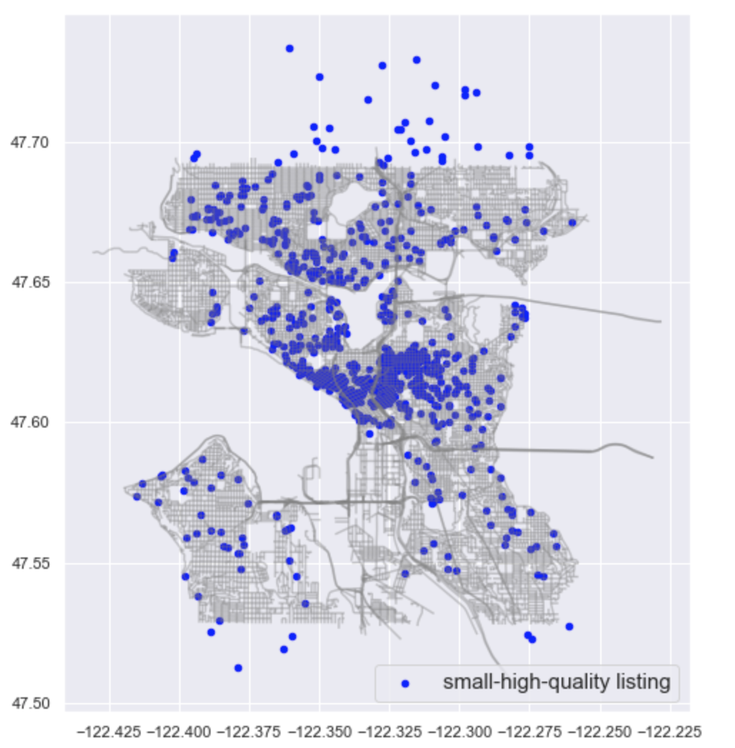
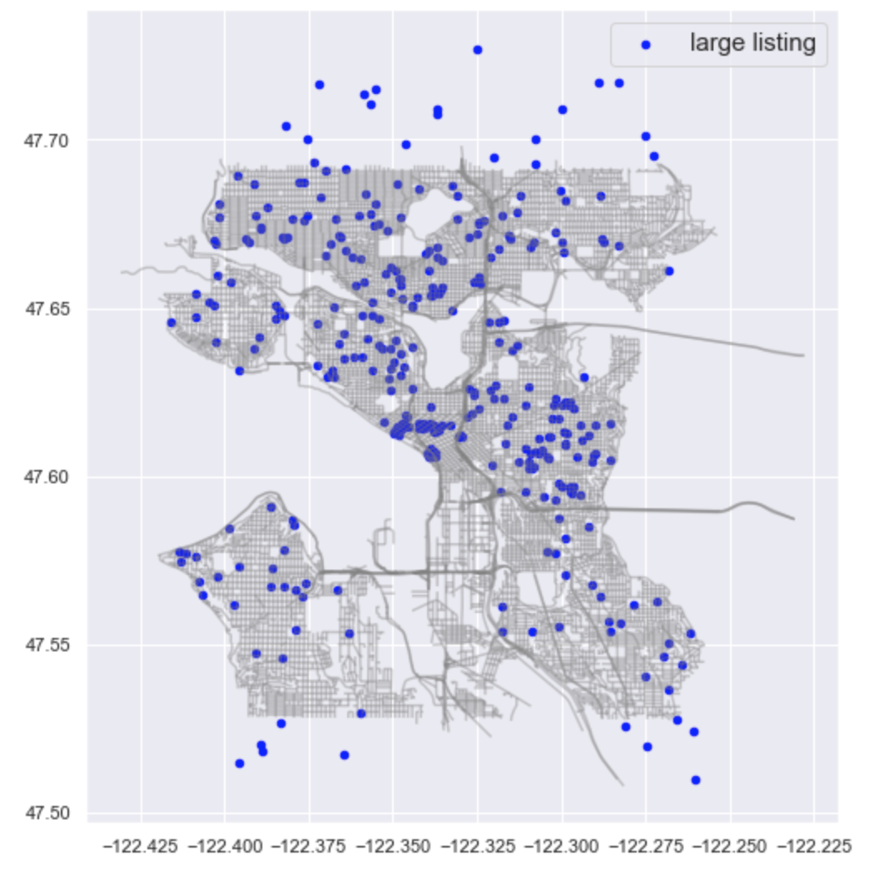
Visualisation of listings distribution
Greatest density of listings (Popular area)
longitude -122.33 latitude 47.62
Small-cheap listings
-density of listings at the popular area lower

Slide 18
PROBLEM
What is a reasonable price for a particular listing?

Slide 19
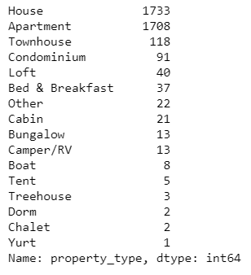
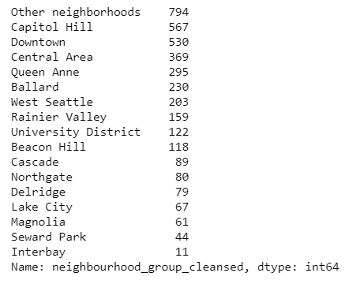
Data Preparation
Removing categories that has too little data

Slide 20
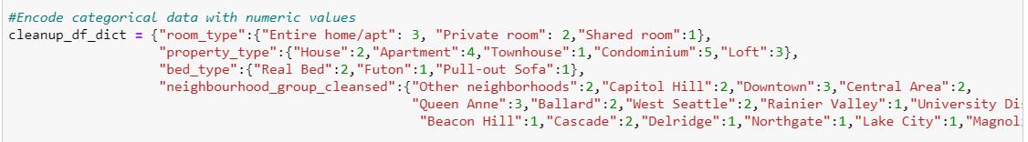
Data Preparation
Removing data with NaN values
Encoding categorical variables with numerical values

Slide 21
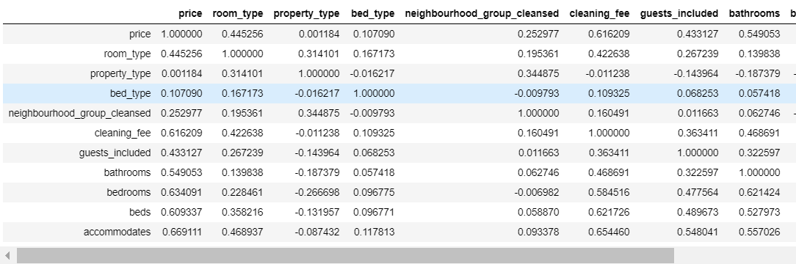
Data Visualisation
Choosing predictors with high correlation with response variable

Slide 22
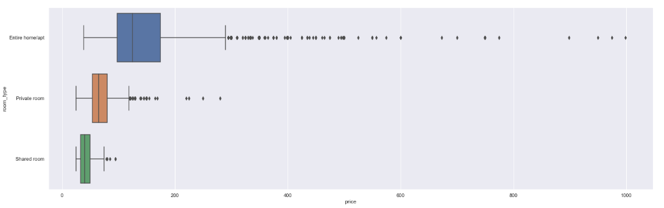
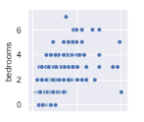
Data Visualisation
Data visualisation on predictors

Slide 23
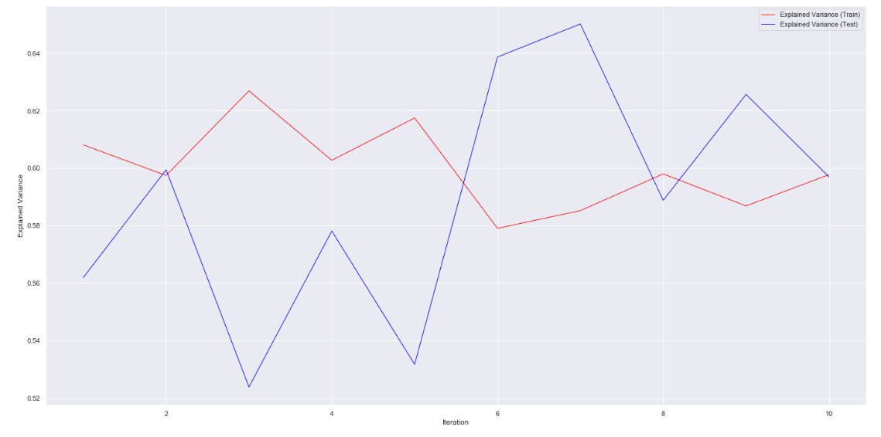
Performing Linear Regression for 10 iterations
Average R^2 of Train Dataset: 0.600
Average R^2 of Test Dataset: 0.590

Slide 24
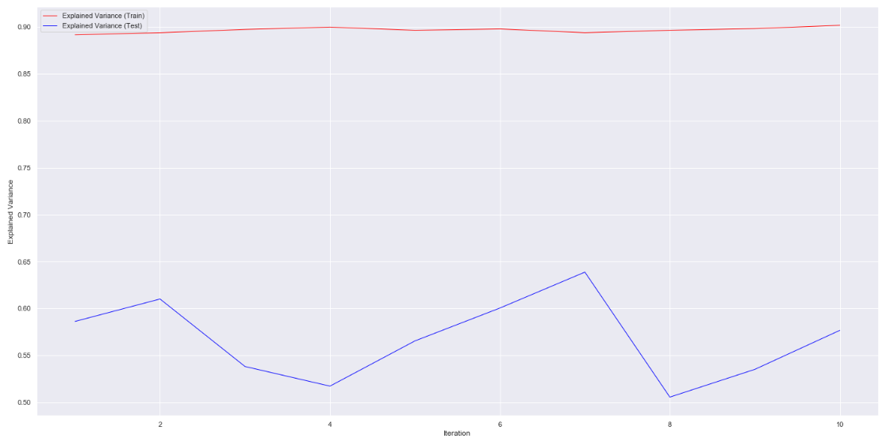
Performing Random Forest Regression for 10 Iterations
Average R^2 of Train Dataset: 0.895
Average R^2 of Test Dataset: 0.561

Slide 25
Performing Linear Regression for Each Cluster
Average R^2 of test data for each cluster are as follows:
small-cheap listing: 0.301
medium listing: 0.562
small-high-quality listing: 0.247
large listing: 0.376
small-low-quality listing: 0.407
Not accurate in predicting prices within clusters
Clusters are already grouped based on predictors
Prices in each cluster are predicted again using the same variables

Slide 26
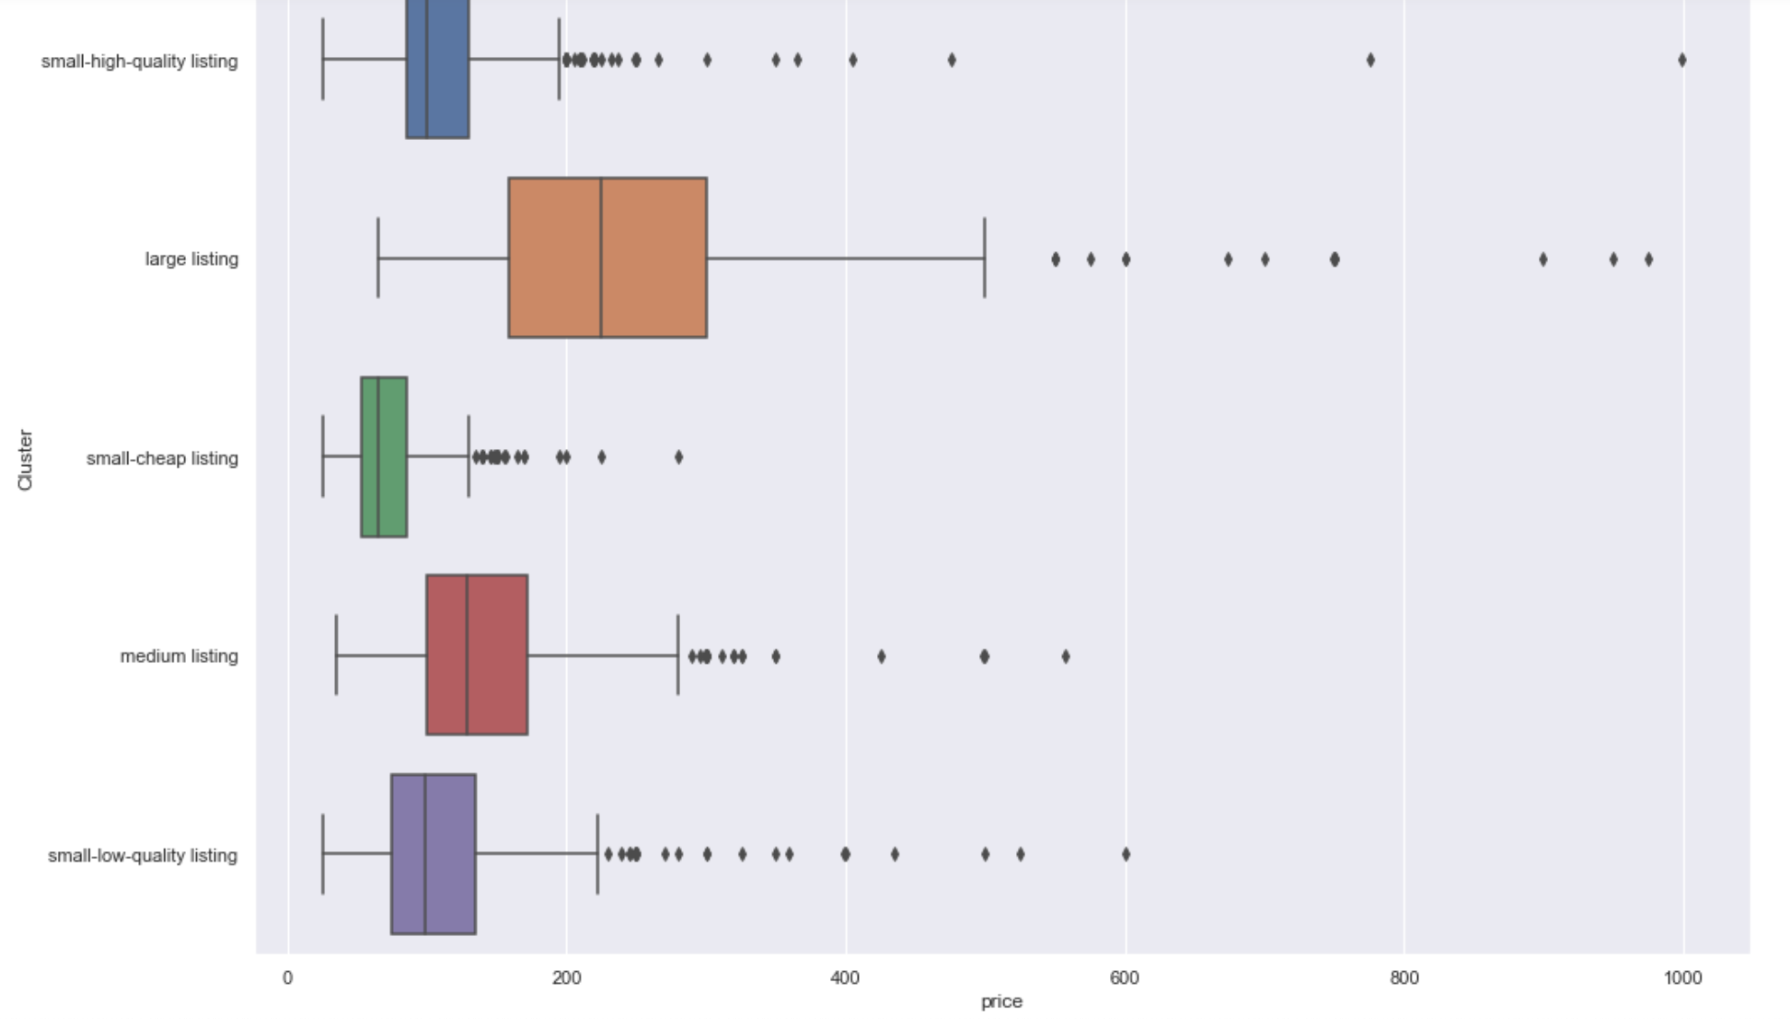
Visualisation of price across clusters
Clear segmentation

Slide 27
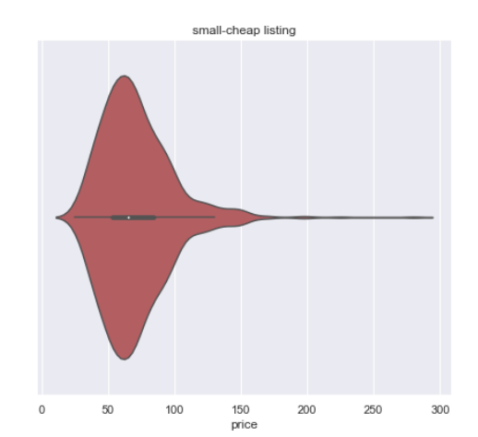
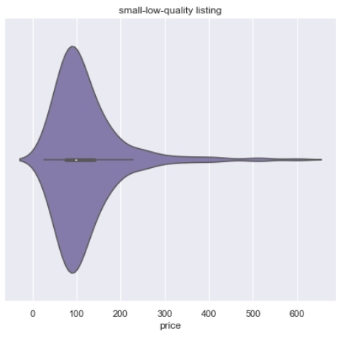
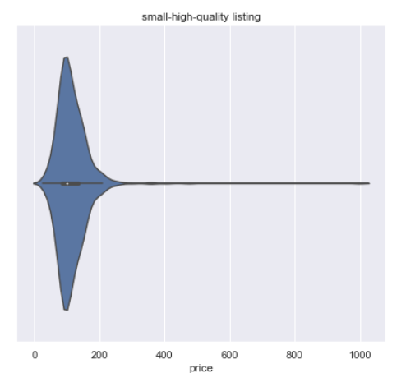
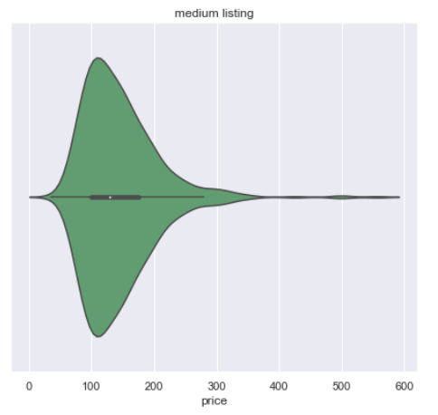
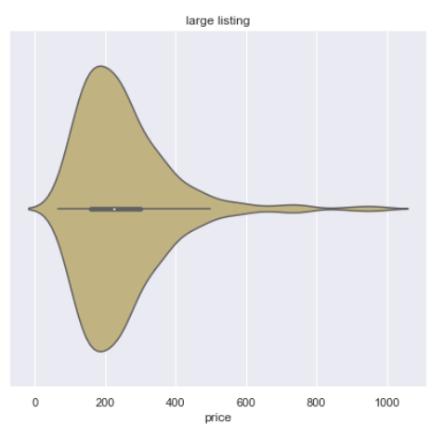
Using Interquartile range to determine reasonable price

Slide 28
PROBLEM
Is there anytime in the year when there are less available listings and higher prices?

Slide 29
Timeseries Of Prices and Available Airbnbs
Problem
Dataset
01
02
Visualisation
ARIMA Model
03
04
Analysis
Inference
05
06
Find relationship between price per month and availability of airbnbs per month.
Calendar dataset is used. It has information of airbnbs available and their prices.
After data cleaning, various data visualisations are carried out like timeseries graphs, bar graphs etc.
Creating and training model for timeseries forecasting.
Analysing the different graphs and the ARIMA model to draw conclusions.
Providing solution to the problem and establishing inferences post analysis.

Slide 30
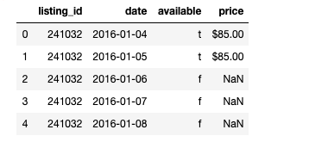
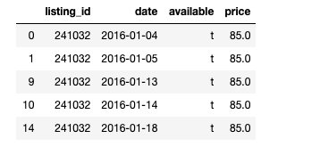
DATA PREPARATION
Original Data has price as non-numeric data and available and unavailable airbnbs together.
We need to convert price into numeric data and separate available airbnbs from the unavailable ones.
BEFORE
AFTER

Slide 31
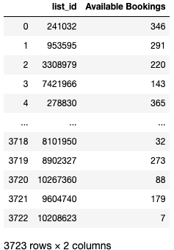
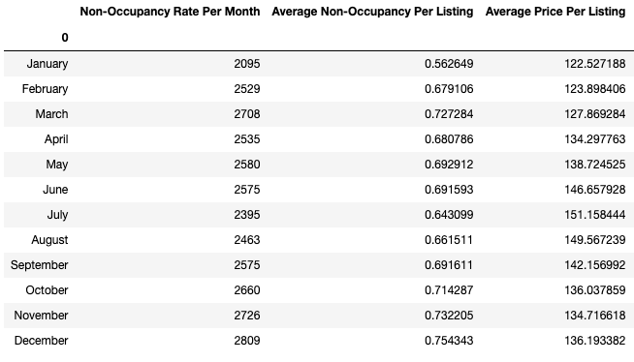
DATA PREPARATION
Dataframe with listing id of each airbnb with its total available bookings is also created.
Another dataframe which consists of occupancy rate per month and average price per month is also created.
We will use this data for our visualisation and analysis.

Slide 32
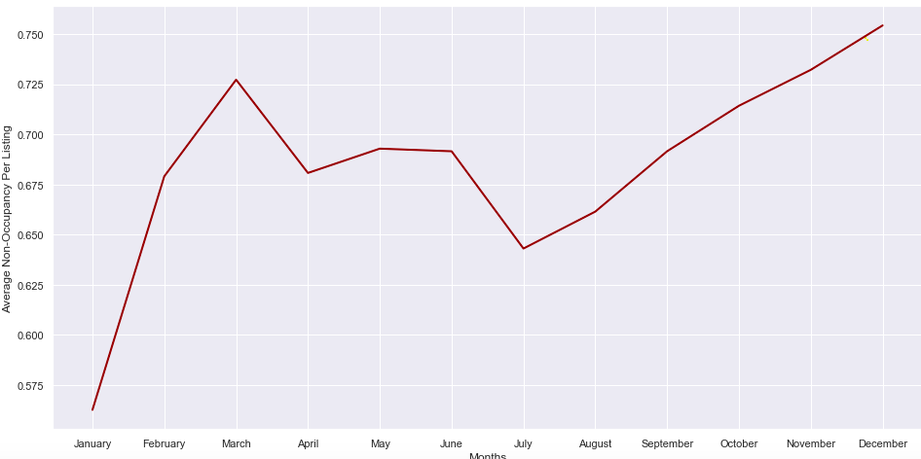
VISUALISATION
Average
Non-Occupancy graph
From the graph, it is seen January-February and July are the busiest months and September to December are the least busiest.

Slide 33
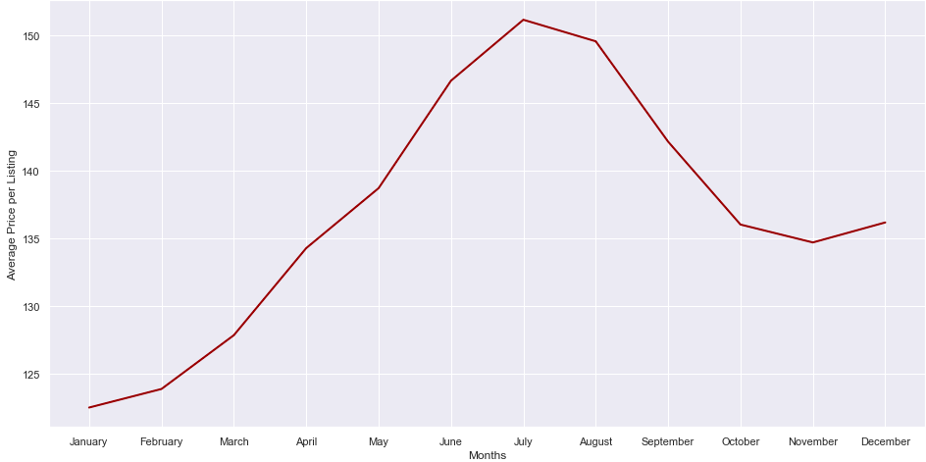
VISUALISATION
Average Price graph
From the graph, it is seen January-February are the cheapest months and June to July are the most expensive months.

Slide 34
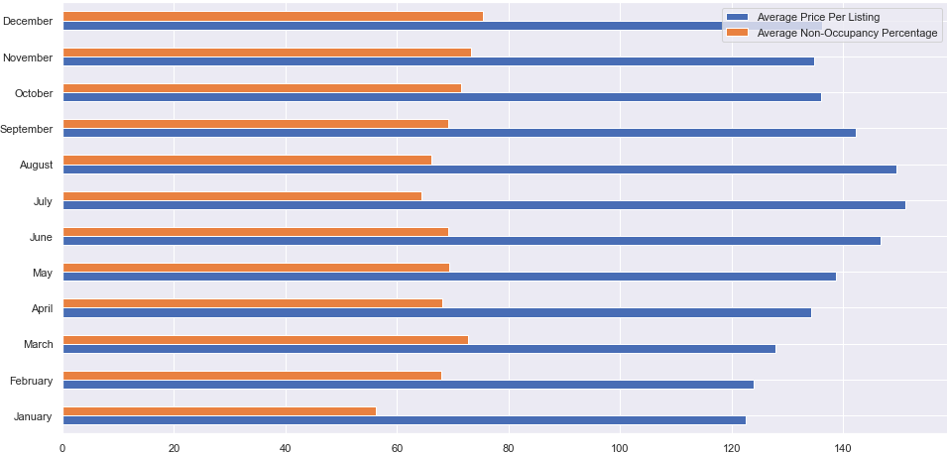
VISUALISATION
Above graph, is a comparative bar graph of average price and average non-occupancy rate per month. These graphs help us in drawing conclusions.

Slide 35
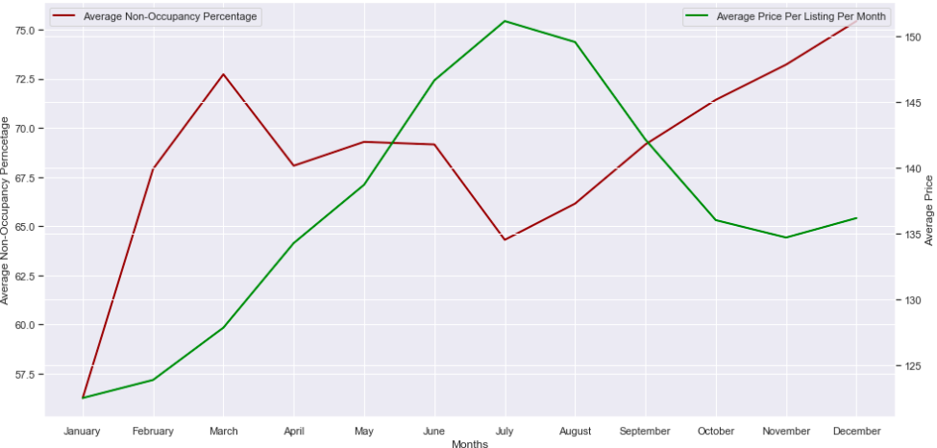
VISUALISATION
We can conclude that January and July months are the peak season for tourism.
From the price graph, we conclude that January has the lowest price.
As a result, although January has unfavourable weather, it is the busiest month due to low prices.
July, being the favoured time to visit Seattle, has the highest price.
Thus, depending on the peak time for tourism, the prices vary.
As a result the non-occupancy rate is affected as well.

Slide 36
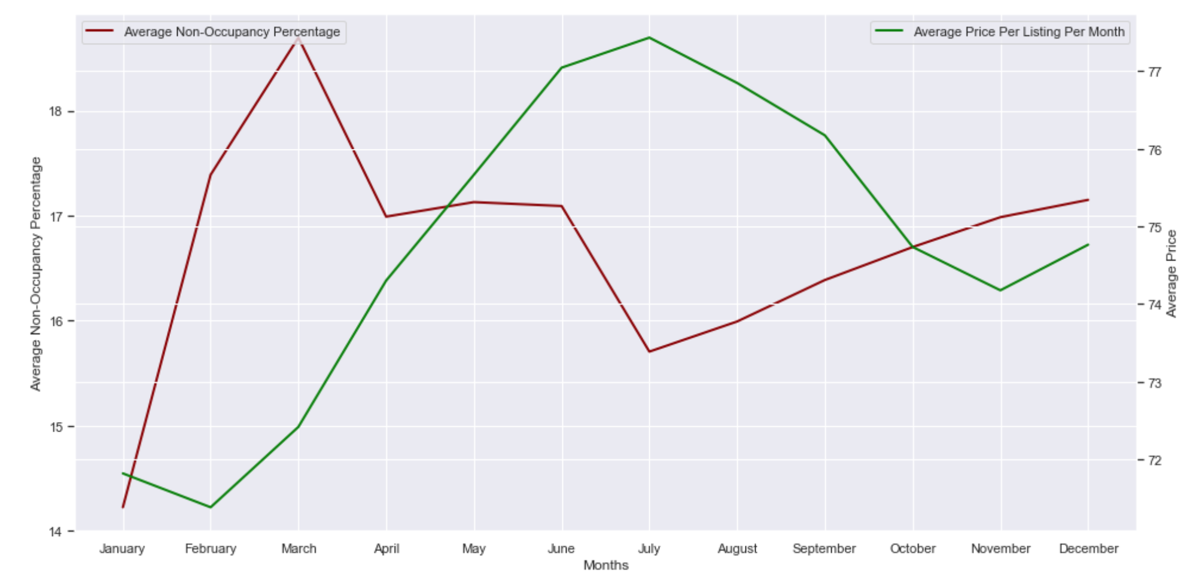
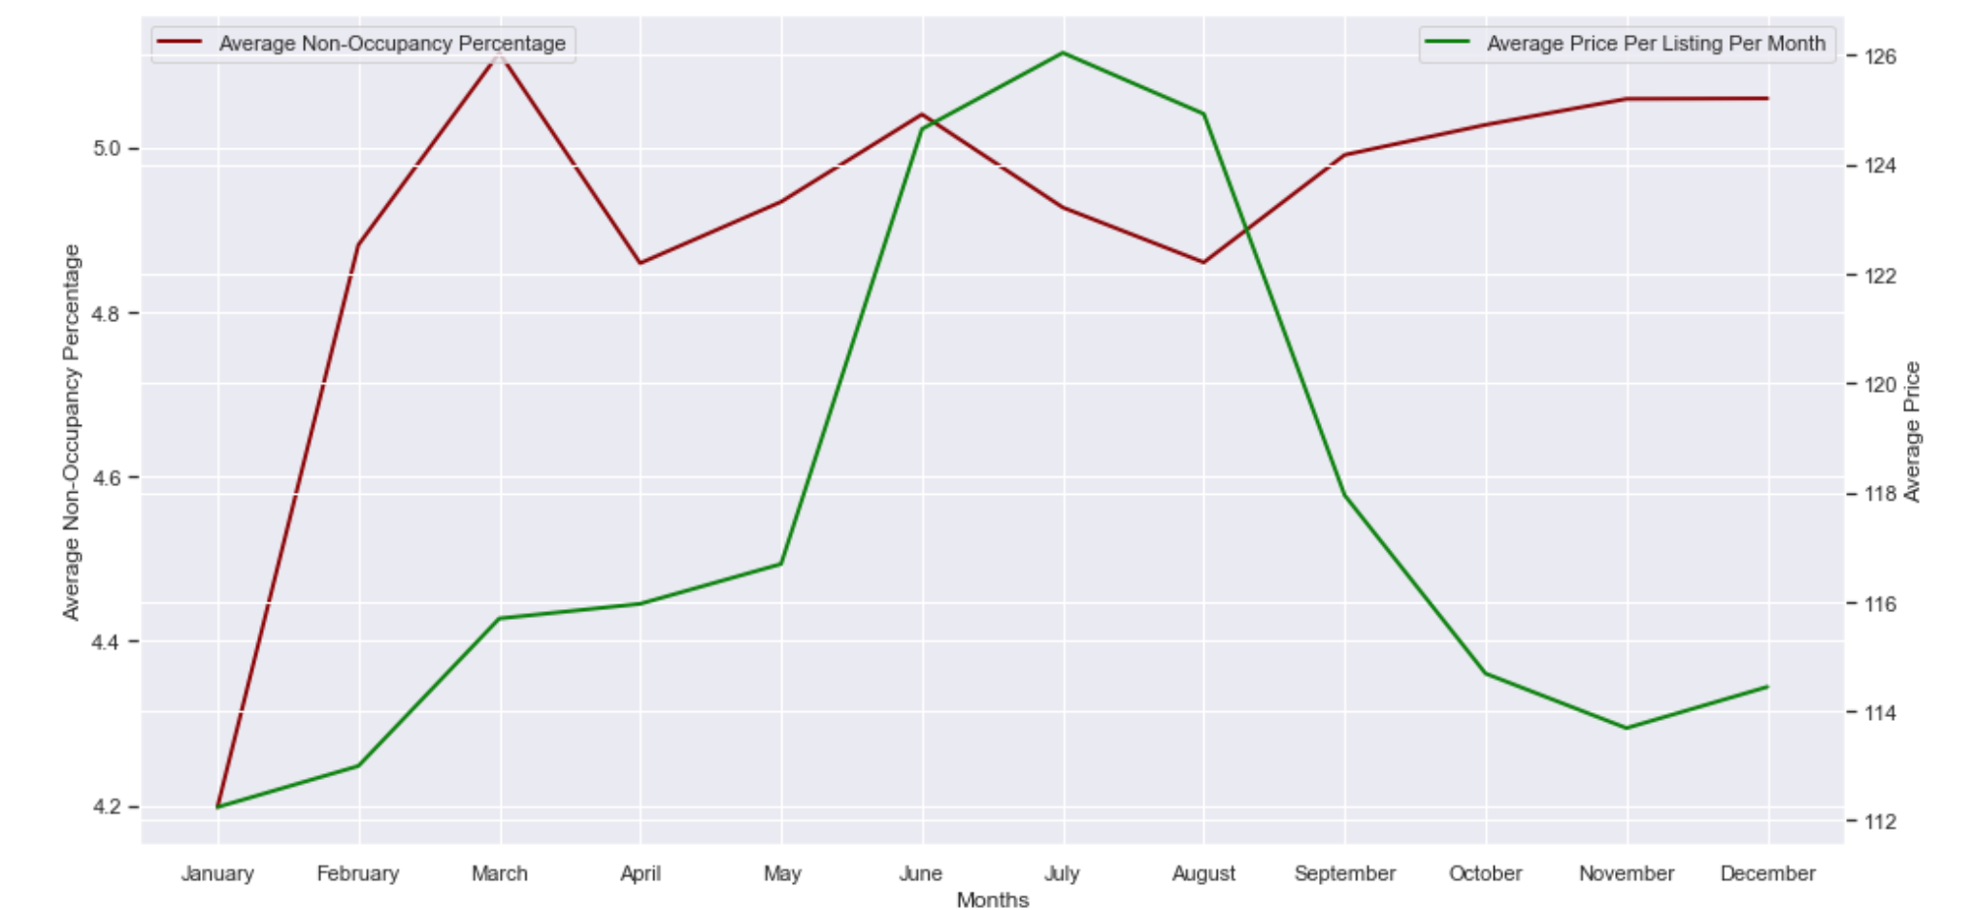
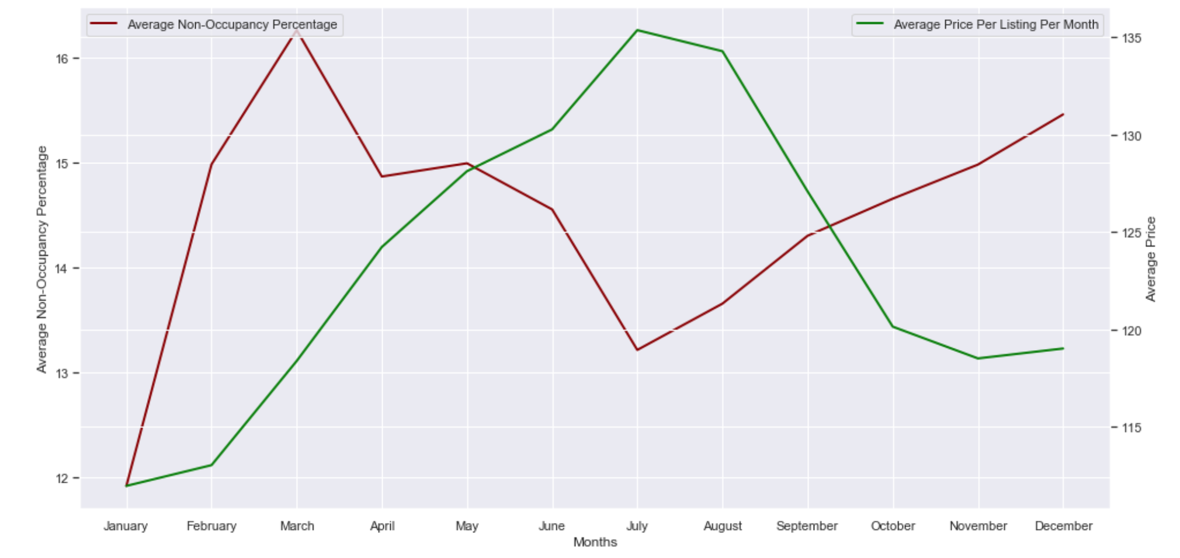
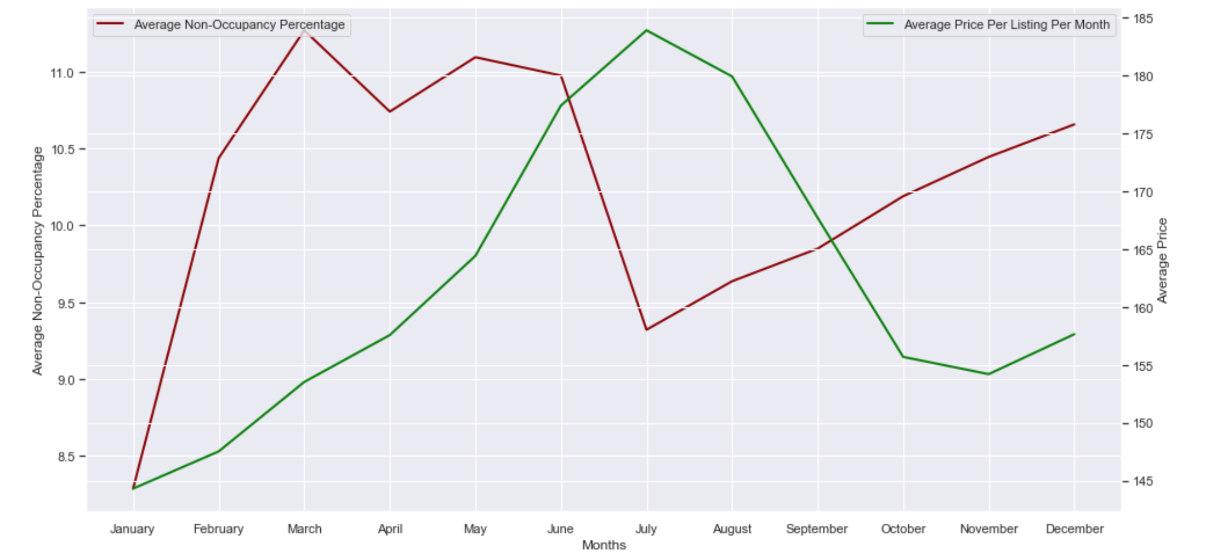
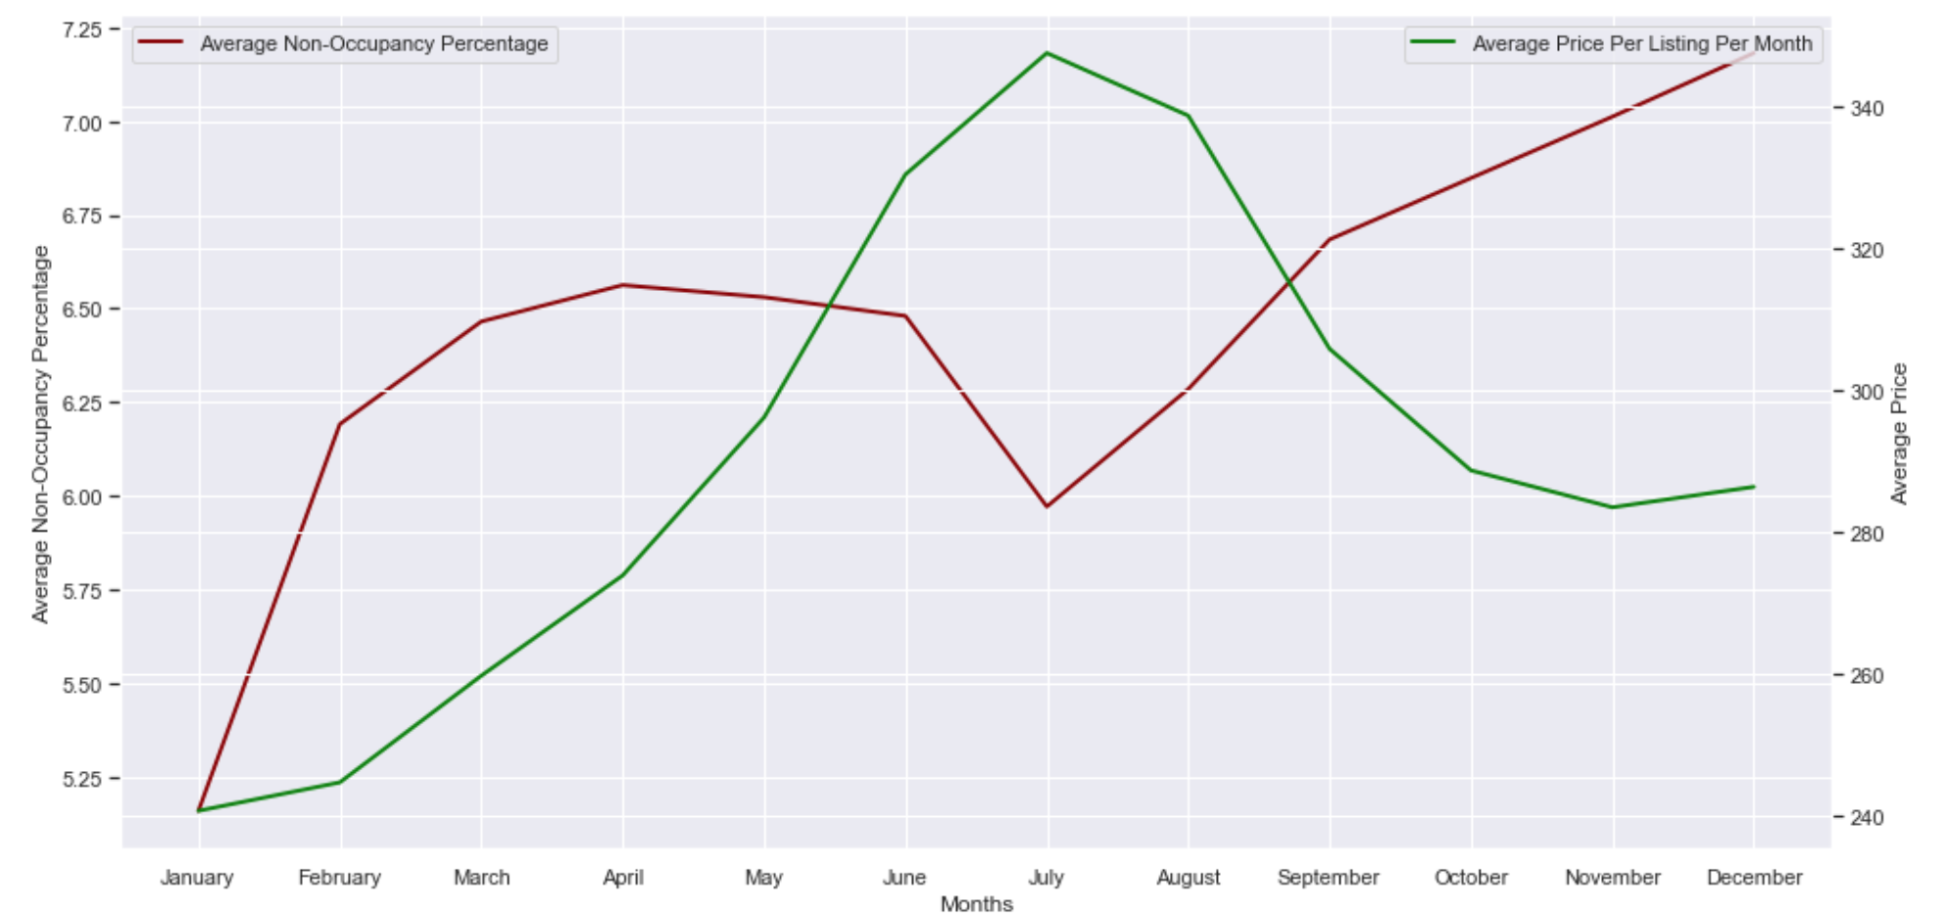
VISUALISATION
Small-cheap listings
Small-low-quality listings
Small-high-quality listings
Medium listings
Large listings
We can also compare the availability and prices per month of each cluster of similar airbnbs.
A similar trend, established before, is observed across all the the clusters.

Slide 37
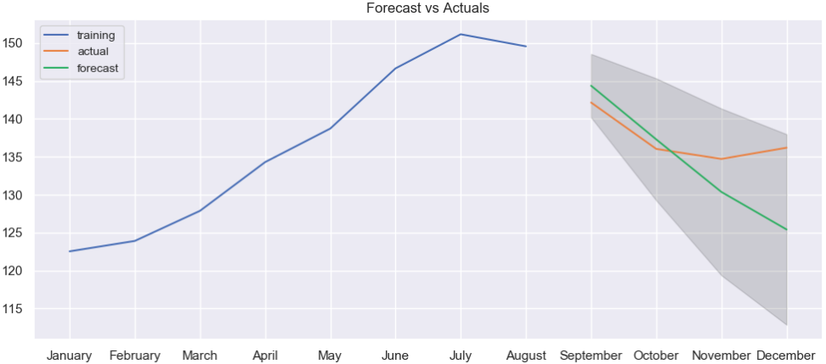
ARIMA MODEL
We create an ARIMA model for predicting average price.
Model is trained using train data (75%) and then prediction is performed on test data (25%).
We can see the comparison between the forecasted and actual graph.
The correlation between actual and forecast is 0.79 indicating a decent prediction.

Slide 38
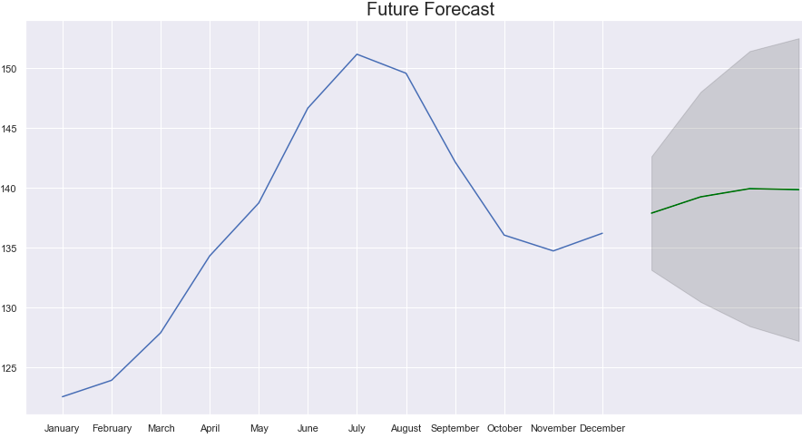
FORECASTING IN FUTURE
The model predicts the price of Airbnbs for the months of January to April of next year.
We can see a rise in price from January to February before the curve flattens.
However, due to insufficient data we cannot be sure about the accuracy of this prediction.

Slide 39
PROBLEM
What is the likelihood of a listing(s) being booked?

Slide 40


DATA PREPARATION
Calendar
Listing
Split date column into year, month, day, weekday
Find the available and non-available and convert the available into binary type
Find columns consist of missing value over 50%
Drop columns with missing values over 50%
Drop columns with URL
Convert ‘cleansing fee’ and ‘host_acceptance’_rate’ into float
01
02

Slide 41
DATA PREPARATION
Review
03
Fill missing comment column in review with ‘?’

Slide 42




Visualisation -Predicting whether a listing will be booked or not
Price
Month
Weekday
Day

Slide 43



Classification -Predicting whether a listing will be booked or not
Using classification
Split into train and test data set with test size=0.25

Slide 44

Visualisation - Time series of occupancy rate
Highest occupancy rate is in January 2016
Spring and summer are the busy season

Slide 45

Visualisation - Time series of median price
High in May to September
Cheapest in January

Slide 46


Visualisation - Using Ridge Regression to estimate the likelihood of booking in year 2017
Higher possibility in January, July, August

Slide 47

Visualisation - features that may affect popularity / likelihood of a listing being booked?
Reply within an hour is more popular
Reply a few days or more is more unpopular

Slide 48

Visualisation - features that may affect popularity / likelihood of a listing being booked?
Apartment is more popular
Houses unpopular rate is higher

Slide 49

Visualisation - features that may affect popularity / likelihood of a listing being booked?
‘flexible’ and ‘moderate’ have higher frequency of popular listing

Slide 50


Visualisation - features that may affect popularity / likelihood of a listing being booked?
Some neighbourhoods have higher likelihood like Cascade while others like Magnolia have lower likelihood
Room type of entire home/apt tend to have higher likelihood of being booked.

Slide 51

Visualisation - things people care most that may affect popularity / likelihood of a listing being booked?
Walking Distance
Great Host
Everything Needed
Great Location

Slide 52
PROBLEM
What ratings would this listing get?

Slide 53



What ratings would this listing get?
Data preparation
Finding correlation coefficient
Variables with moderately strong linear relationship with review_scores_ratings:
-review_scores_accuracy -review_scores_communication
-review_scores_cleanliness -review_scores_value
-review_scores_checkin

Slide 54




Pairplot
x-axis : review_scores_rating
Positive correlation between variables and review_scores_rating

Slide 55







Visualisation of
categorical data
room_type
host_is_superhost
bed_type
No clear segmentation of review_scores_rating across categories of each variable
host_response_time
property_type
cancellation_policy
neighborhood_group_cleansed

Slide 56


Random Forest Regression to predict ratings
Relatively accurate model

Slide 57


Linear Regression to predict ratings
Relatively accurate model, less accurate than random forest

Slide 58





Random forest regression on clusters
Small-low-quality listings
Small-cheap listings
Small-high-quality listings
Medium listings
Large listings
Prediction based on entire dataset more accurate

Slide 59





Performance evaluation (using cross validation score)
Prediction of price (random forest regression)
Prediction of ratings (random forest regression)
Prediction of price (linear regression)
Prediction of ratings (linear regression)
Prediction of exact visitor count (ridge regression)
Explained variance can vary across iterations - cross_val_score can be used to determine accuracy
Most are accurate

Slide 60
Conclusion
Determine if price is reasonable
Be aware of peak and off-peak seasons and plan accordingly
Be informed of whether a listing will be booked or not in a given period
Understand what affects ratings to choose good listings

Slide 61
THANKS
Do you have any questions?
Please keep this slide for attribution

